Slide 1
Bayesian Uncertainty Estimation of Ultrasound Medical Image Segmentation
Machine Learning (XAI501) Term Project
Sunwoo Kim¹, Kwanseok Oh², Jinhyo Shin², Sangjin Kim²
¹Department of Computer Science and Engineering,
²Department of Artificial Intelligence
Notes:
Hello my name is ???,
We are going to give a presentation on this topic : Bayesian Uncertainty Estimation of Ultrasound Medical Image Segmentation

Slide 2
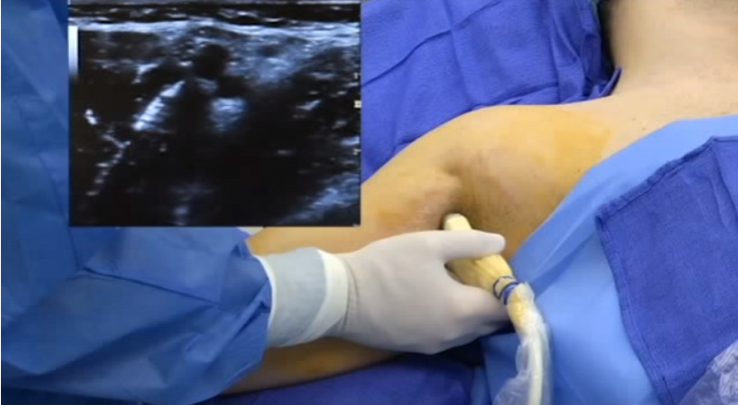
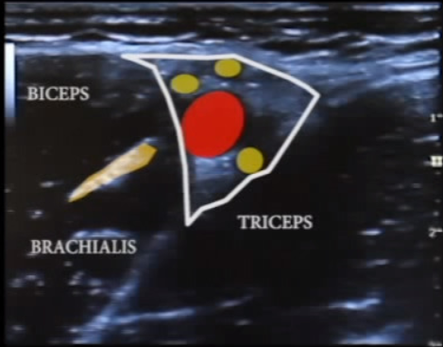
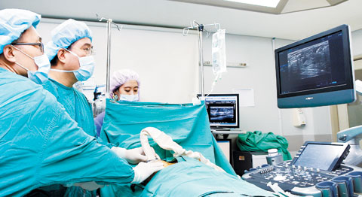
Introduction (1)
Use of Ultrasonic Test for Anesthesia of
Upper Neural Guns
쓰임새 넓어진 초음파.. 수술 중 안보이는 암도 찾아내 -헬스조선 2014/12/03
https://m.health.chosun.com/svc/news_view.html?contid=2014120202552
Notes:
Ultrasound examination is highly used in various medical procedure.
Because, different structures in the body reflect ultrasound wave differently, many doctors use it as a visual tool to find a specific organs, tissues, blood flow, even nerve.
Thanks to these characteristic, ultrasound is very useful as an aid tool.

Slide 3
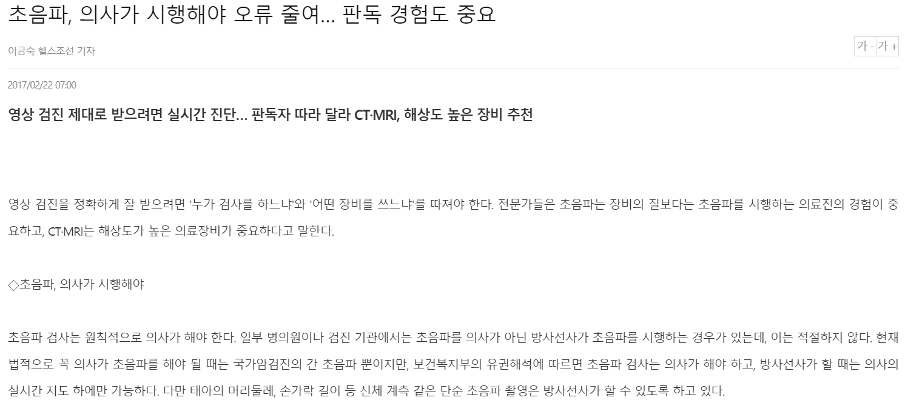
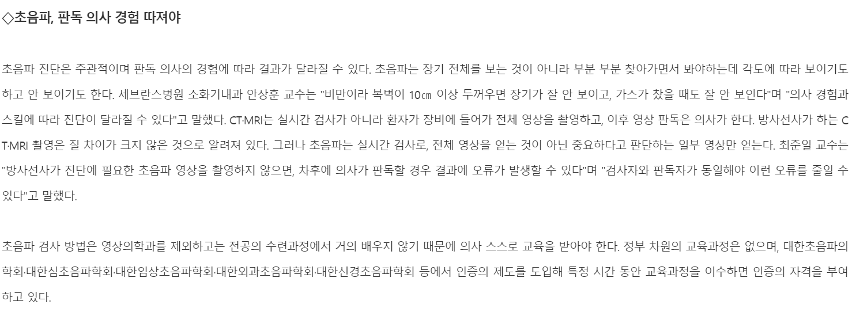
Introduction (2)
Notes:
However, Sonographers, who perform ultrasound examinations, require a lot of proficiency to distinguish different organs in the visual image of ultrasound.
In addition, misdiagnosis may occur because the accuracy of the test is affected by the condition of the Sonographers.
This misdiagnosis is very dangerous because it is able to cause fatal damage to a patient's tissues during surgery.
In particular, the nerves are very difficult to recover once they are damaged, so more attention is required during the medical procedure.

Slide 4
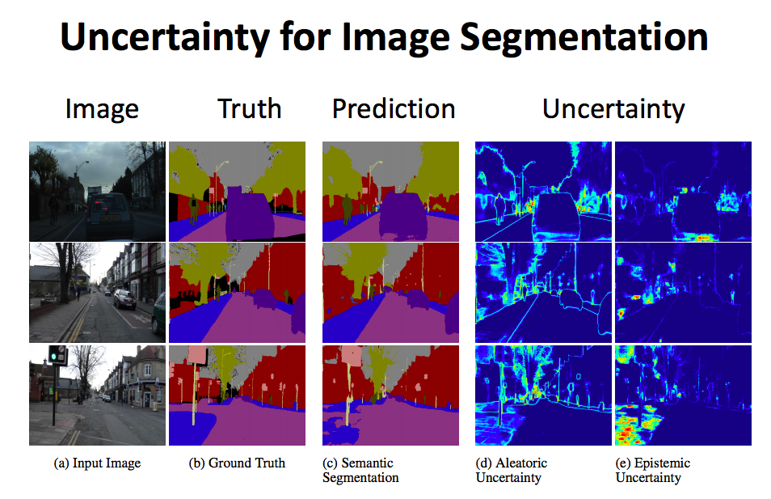
Introduction (3)
Segmentation Uncertainty map from Bayesian SegNet
Notes:
So, we want to make a detector that segments nerves in an ultrasound image as a tool to assist the proficiency of Sonographers by using semantic segmentation technique.
But, there is a limitation because there may always be a question of whether the results are completely reliable.
Therefore, we made the network to play the same role as the Bayesian network, which can reflect uncertainty by using dropout when performing image segmentation

Slide 5
Datasets (1)
Brachial plexus
5,635 pair train image with masks & 5,508 single test image (no masks)
Reduce missing data, and then remain 2,323 pair training set
Image size : 1x420x580 with gray scale
Notes:
We use Brachial plexus nerve image dataset opened in kaggle.
There are 5635 pair training image with mask and 5508 single test image
We reduce the no labeled data in training set and then we use 2323 pair of training dataset.

Slide 6
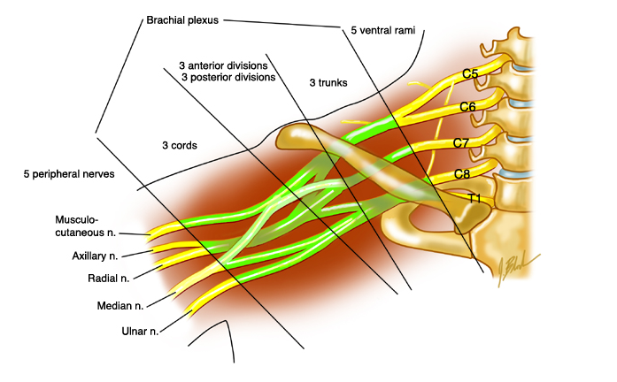
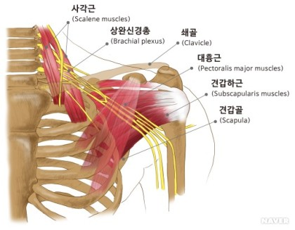
Datasets (2)
BP begins near the neck and controls the movement and senses of the upper extremities, including shoulders, upper limbs, forearms and hands.
Notes:
Here is the image where the BP is.
BP begins near the neck and controls the movement and senses of the upper extremities, including shoulders, upper limbs, forearms and hands.

Slide 7
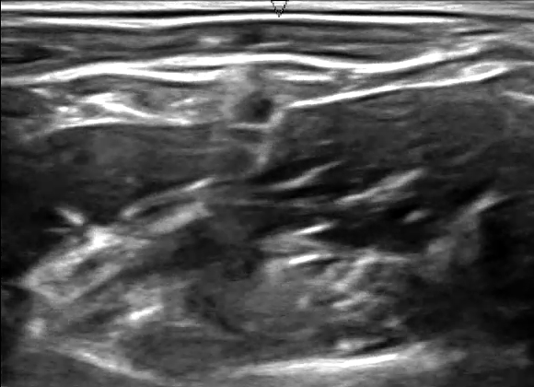
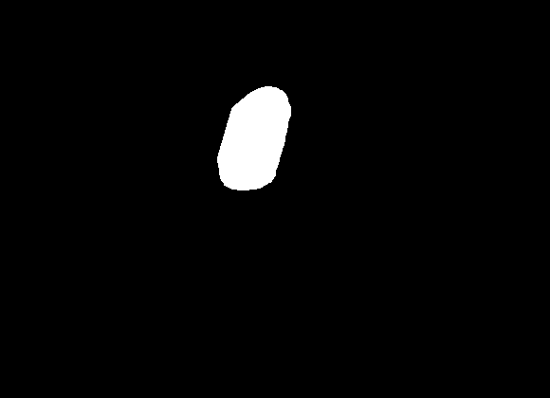
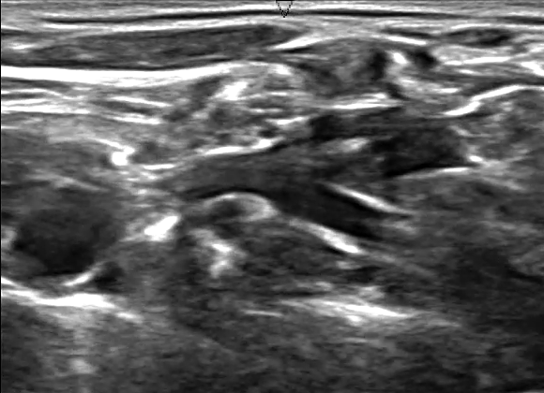
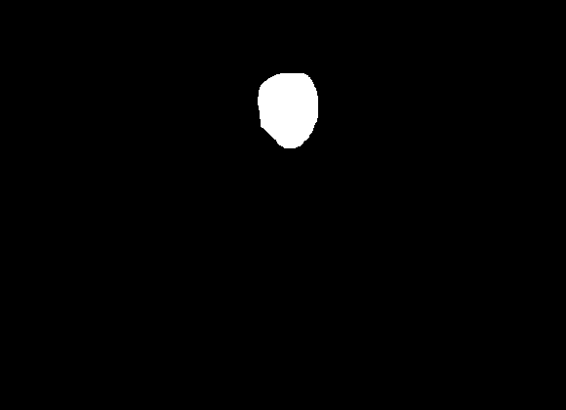
Datasets (3)
Image
Label
Image
Label
Notes:
And these are the pair of input image and label samples

Slide 8
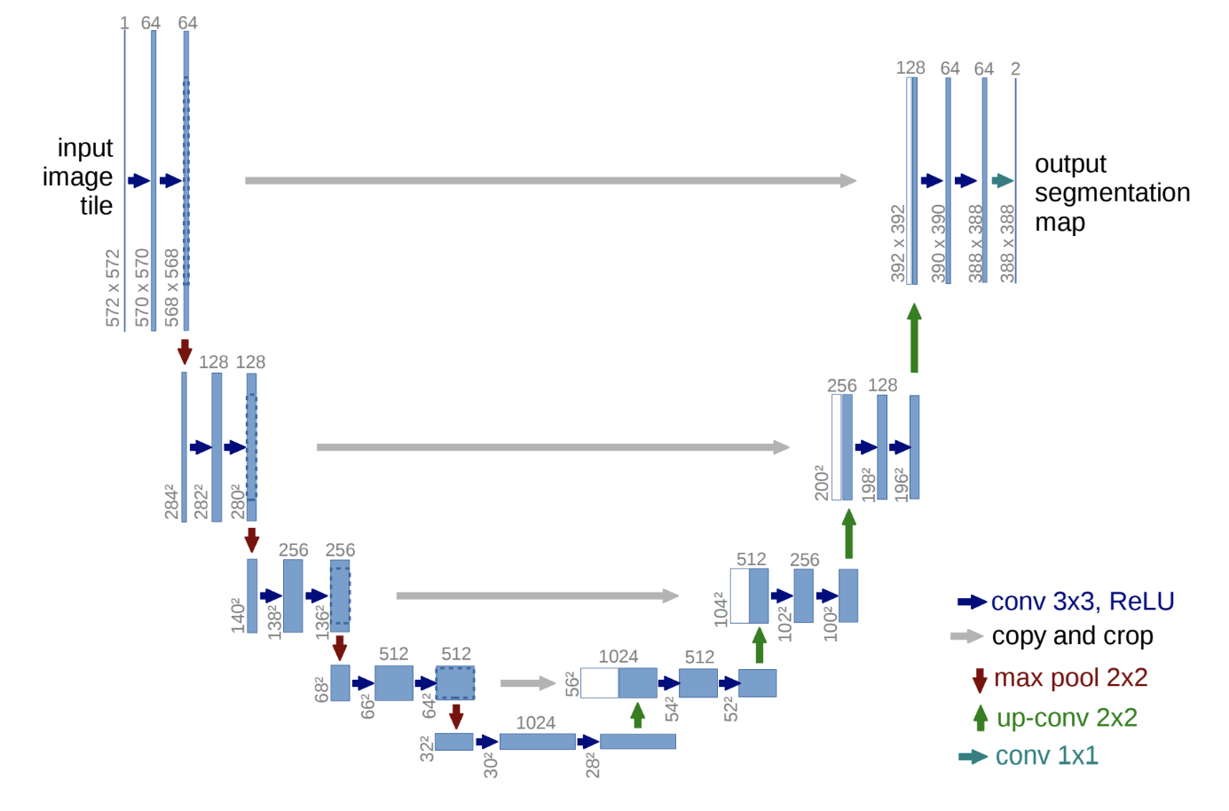
Method (1)
U-Net
Adjust output channels
(64, 128, 256, 512, 1024) -> (32, 64, 128, 256, 512)
Add dropout after convolutional block
Notes:
We use U-Net which is well-known architecture in the semantic segmentation task especially biomedical images.
We adjust the output channel of the standard U-Net to avoid overfit because the input image is an single channel gray-scale image.
And we add dropout after convolutional block to make normal network to bayesian network.

Slide 9
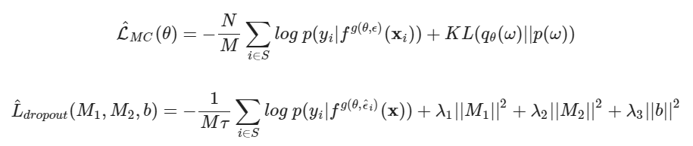
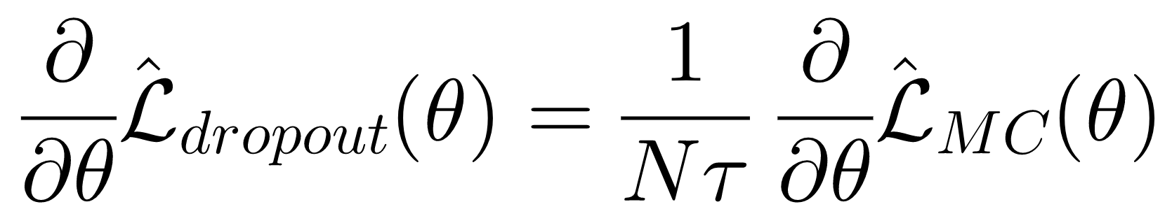
Method (2)
The objective of NN-dropout and BNN is almost same:
The difference is as follows:
Regularization term (KLD vs. weight decay)
Scale of objective
If we adjust the regularization term:
Notes:
The way we propose is to equate it with the algorithms of Bayesian neural networks that can reflect uncertainty using dropouts.
Basically the Bayesian neural network determines the probability distribution of weight, not the support of weight through learning.
Neural networks with dropouts do not perform learning for all layers of the neural network, but rather omit some neurons in the input layer or the Hidden layer of the neural network and perform learning through the reduced neural network.
In other words, adjusting the formula in a way that reduces differences based on objective similarity will have the effect of making the result almost identical to the official result value of BNN.

Slide 10


Method (3)
To measure uncertainty we followed metrics which is used in related work.
Uncertainty Metrics (qualitative)
Predictive Entropy
Mutual Information
Performance Evaluation Metrics (quantitative)
1)
MUKHOTI, Jishnu; GAL, Yarin. Evaluating bayesian deep learning methods for semantic segmentation. arXiv preprint arXiv:1811.12709, 2018.
Notes:
To measure uncertainty of our model, we followed metrics which is used in related work.
We measures in two approaches. One is qualitative and the other is quantitative.
Qualitative methods give us uncertainty map which is same size with input image. We can see intuitively the pixels where model is not confident.
Predictive entropy measures uncertainty from training data, and Mutual information measures expanded uncertainty considering the noises in data.
The quantitative measurement method uses the probability of uncertainty and accuracy.

Slide 11
Experiment (1)
Hyperparameter Settings
Hyper-parameter setting for model training
Learning rate | 0.001
Learning decay (exponential) | 0.99
Epoch | 150
Batch size | 8
Dropout rate | 0.2
Weight constraint | 0.0001
Notes:
The overall hyper parameter settings for model training are as follows. In the case of the learning rate, we tried all the experiments for 0.001, 0.0001, and 0.00001, but there was no significant difference in the performance of the selected model, and we could only confirm the difference in the training step. Also, we tried setting the dropout ratio to 0.5, but we confirmed that it does not train when the dropout is too high. Therefore, this setting have derived the best result.

Slide 12
Experiment (2)
Ablation Study
Performance of our Baseline U-Net without dropout
Metric | Mean |  | Std
F1 | 0.8113 |  | 0.000559
Ablation study for major component analysis
 | Loss | IoU | P(accurate|certain) | P(uncertain|inaccurate)
Encoder | 0.4006 | 0.6046 | 0.9716 | 0.1225
Decoder | 0.3089 | 0.6241 | 0.9731 | 0.1104
Both | 0.3138 | 0.6015 | 0.9612 | 0.1475
Notes:
Also, we conducted an ablation study on the method we proposed.
The F1 score at the top of the table is the result value for standard U-net, and below is the ablation score for the position of the dropout layer. In conclusion, there was not much difference in performance no matter where dropout was used, and both P (accurate|certain) and P (uncertain|incurate) were stable.
Here, P(accurate|certain) is the probability that the model is accurate on its output given that it is confident on the same, and P(uncertain|inaccurate) is the probability that the model is uncertain about its output given that it has made a mistake in its prediction (i.e., is inaccurate)

Slide 13
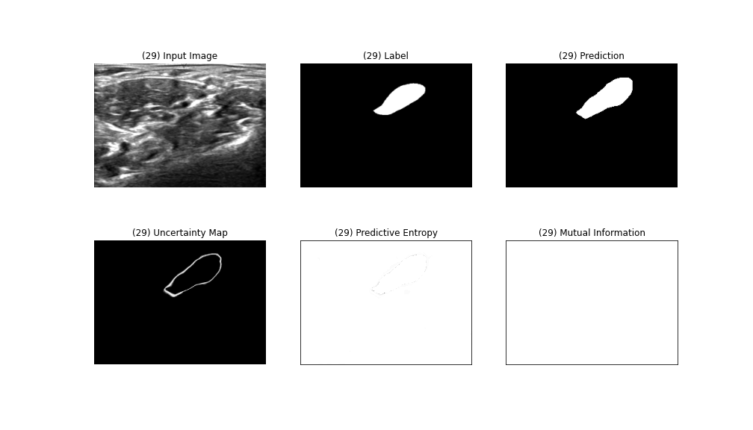
Inference Image (1)
Notes:
The result is an image with an IoU core of 0.7834.
As you can see, areas of label and prediction are similarly matched, and the uncertainty map shows that only the part of the nervous boundary is high.

Slide 14
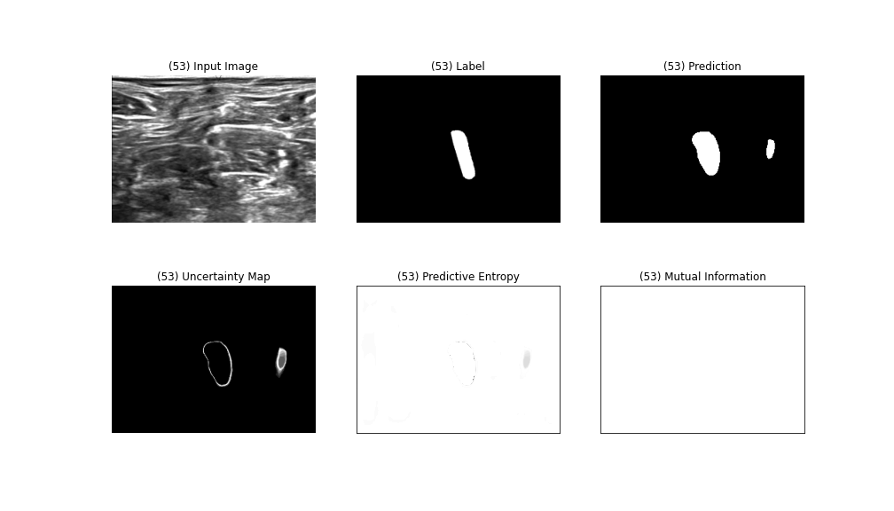
Inference Image (2)
Notes:
In contrast, this result is an image with a low IoU core of 0.6201. The IoU is also found to be low because it predicted nerve-free parts just by looking at the image.
What can be seen as significant is that if these results are obtained during a general semantic segmentation, they can be determined as a failed prediction.
However, if you look at the uncertified map, it can give important information to the clincians because the uncertified part provides high-lighted results intuitively for the nerveless part.

Slide 15
Conclusion
This method can be further extended to include other downstream applications as well where semantic segmentation is a useful intermediate tool
These results may contribute to the Sonographer to identify areas of uncertainty in the nerves when detecting the nerve
Notes:
This method can be further extended to include other downstream applications as well where semantic segmentation is a useful intermediate tool
Also, These results may contribute to the Sonographer to identify areas of uncertainty in the nerves when detecting the nerve
Thank you for listening to my presentation.

Slide 16
Reference (1)
[1] Alex Kendall, Yarin Gal, What Uncertainties Do We Need in Bayesian Deep Learning for Computer Vision?, arXiv:1703.04977, NIPS 2017
[2] Yarin Gal, Zoubin Ghahramani, Dropout as a Bayesian Approximation: Representing Model Uncertainty in Deep Learning, arXiv:1506.02142, ICML 2016
[3] Olaf Ronneberger, Philipp Fischer, Thomas Brox, U-Net: Convolutional Networks for Biomedical Image Segmentation, arXiv:1505.04597, MICCAI 2015
[4] Alex Kendall, Vijay Badrinarayanan, Roberto Cipolla, Bayesian SegNet: Model Uncertainty in Deep Convolutional Encoder-Decoder Architectures for Scene Understanding, arXiv:1511.02680, British Machine Vision Conference 2017
[5] Fausto Milletari, Nassir Navab, Seyed-Ahmad Ahmadi, V-Net: Fully Convolutional Neural Networks for Volumetric Medical Image Segmentation, arXiv:1606.04797, Fourth International Conference on 3D Vision(3DV) 2016
[6] Carole H Sudre, Wenqi Li, Tom Vercauteren, Sébastien Ourselin, M. Jorge Cardoso, Generalised Dice overlap as a deep learning loss function for highly unbalanced segmentations, arXiv:1707.03237, 2017
[7] Shruti Jadon, A survey of loss functions for semantic segmentation, arXiv:2006.14822, SPIE Medical Imaging 2020
[8] GAL, Yarin. Uncertainty in deep learning. University of Cambridge, 2016, 1.3.
[9] MUKHOTI, Jishnu; GAL, Yarin. Evaluating bayesian deep learning methods for semantic segmentation. arXiv preprint arXiv:1811.12709, 2018.
Notes:
This is our reference.

Slide 17
Reference (2)
[10] “Ultrasound Nerve Segmentation.” kaggle. last modified May 19, 2016, accessed Oct 22, 2020, https://www.kaggle.com/c/ultrasound-nerve-segmentation/data.
[11] Teye, Mattias, Hossein Azizpour, and Kevin Smith. "Bayesian uncertainty estimation for batch normalized deep networks." arXiv preprint arXiv:1802.06455 (2018).
[12] Harakeh, Ali, Michael Smart, and Steven L. Waslander. "Bayesod: A bayesian approach for uncertainty estimation in deep object detectors." 2020 IEEE International Conference on Robotics and Automation (ICRA). IEEE, 2020.
[13] Maddox, Wesley J., et al. "A simple baseline for bayesian uncertainty in deep learning." Advances in Neural Information Processing Systems. 2019.
Notes:
Thank you

